Slide 1
Hoyle state
Seminar 1.
1. year of Master‘s degree
Author: Matic Tonin
Mentor: Miha Mihovilovič

Slide 2
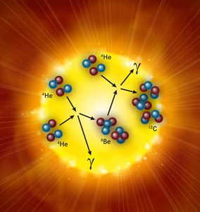
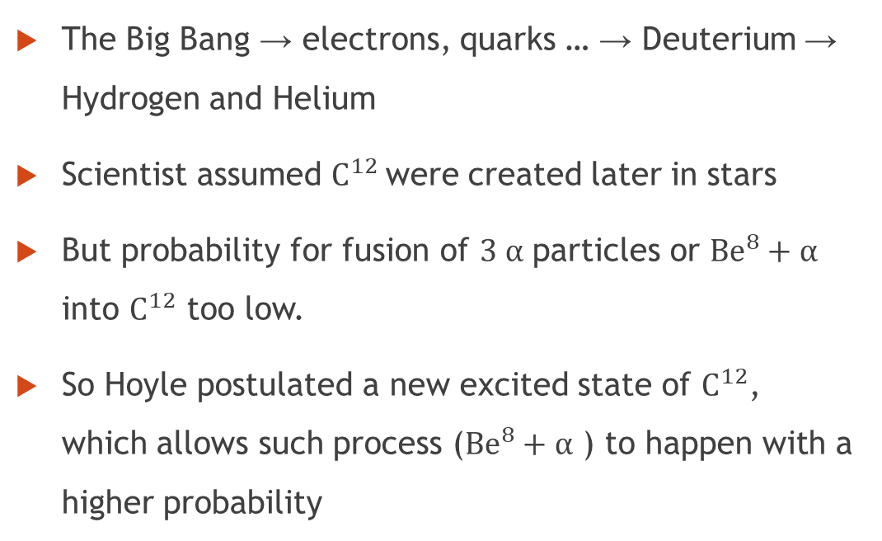
Introduction
The Big Bang → electrons, quarks … → Deuterium → Hydrogen and Helium
Scientist assumed $C^{12}$were created later in stars
But probability for fusion of $3 α$ particles or ${Be}^{8}+α$ into $C^{12}$ too low.
So Hoyle postulated a new excited state of $C^{12}$, which allows such process (${Be}^{8}+α$ ) to happen with a higher probability

Slide 3

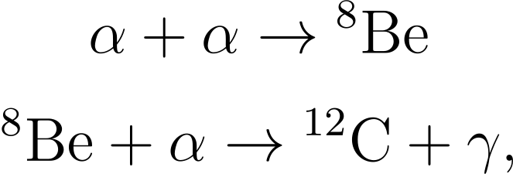
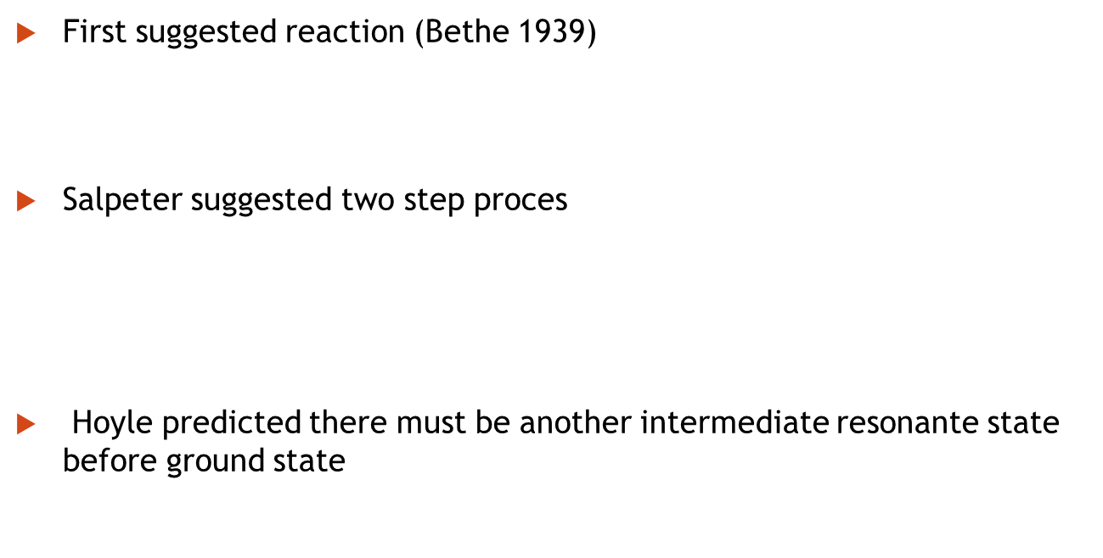
Discovery of Hoyle state
First suggested reaction (Bethe 1939)
Salpeter suggested two step proces
Hoyle predicted there must be another intermediate resonante state before ground state
Stars are to cold for such probable process
The probability of such reaction still does not explain abundance in space

Slide 4
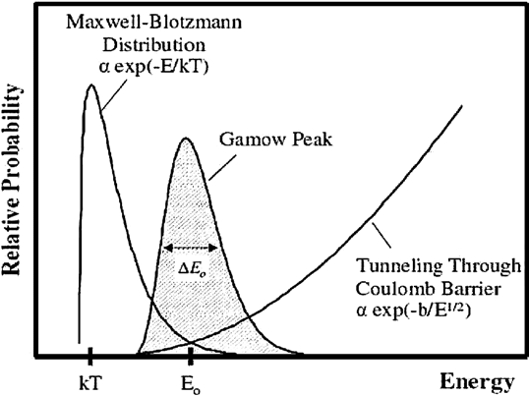

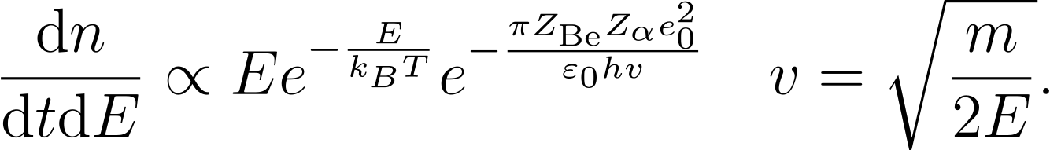
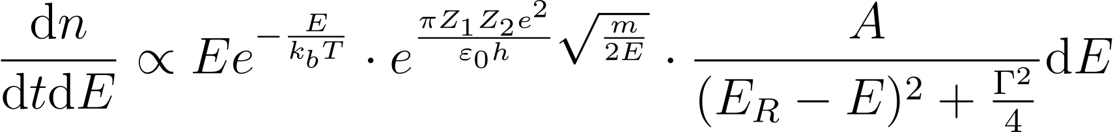
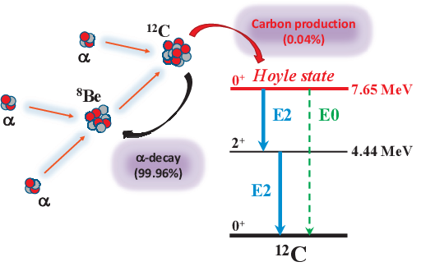



Discovery of Hoyle state
Number of collisions of Be and is described as
If the reaction happens via an intermediate resonant state, we add the Briet-Wigner factor
Hoyle proposed an additional excited $0^{+}$ state with resonance energy of excitation energy of

Slide 5

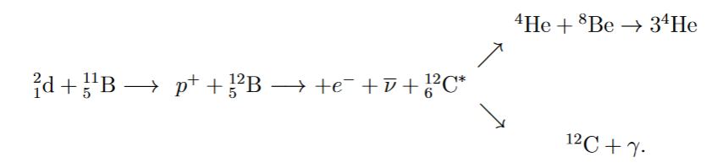
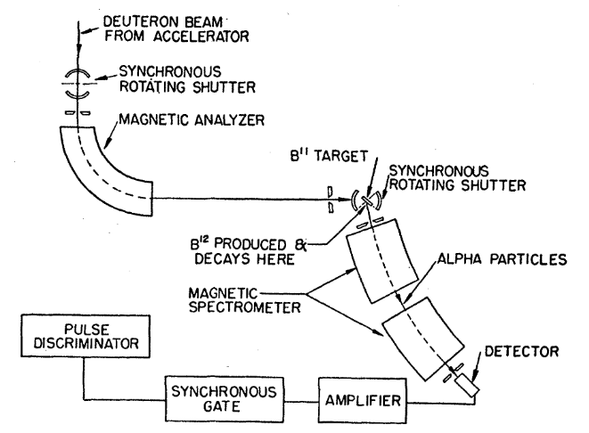
Measurements of Hoyle state
First measurement of Hoyle state
Was made in 1957 by Cook by using Boron and Deuterium to create
In the experiment they measured the energies of particles, which were detected by the magnetic spectrometer.
Reaction rate of such reaction:

Slide 6
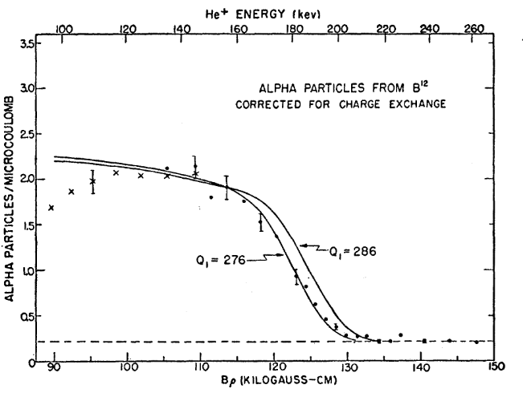
Measurements of Hoyle state
First measurement of Hoyle state
Assumptions: 1. Ground state of C is stable 2. Berilium does not decay into 2 particles.
Energy equation of excited state:
Which resulted in the enegry of Hoyle state:

Slide 7
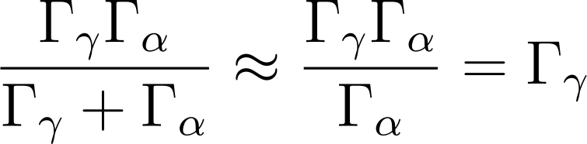
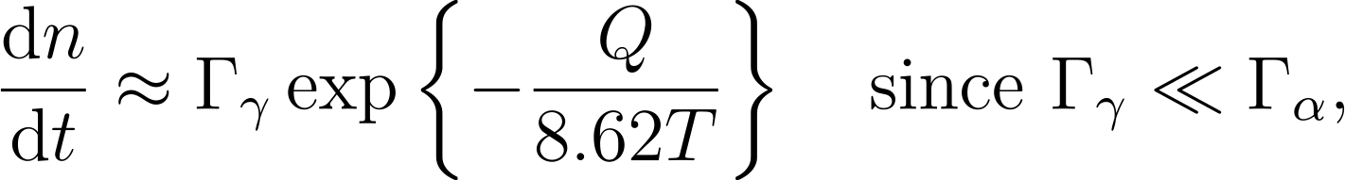

Measurements of Hoyle state
First measurement of Hoyle state
They also concluded that spin is $J=0^{+}$ and must play a dominant role in the synthesis of elements from Helium.
They did not take into account $γ$ decay of with approximation
Which gave them

Slide 8
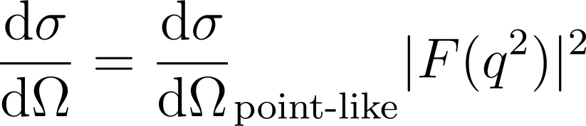
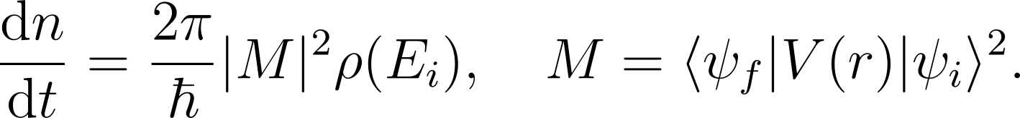
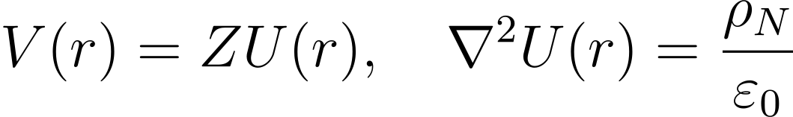
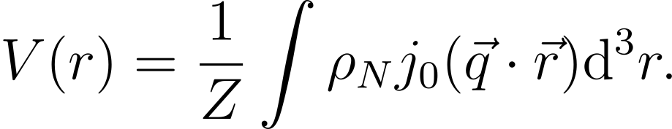
Measurements of Hoyle state
Modern measurements of Hoyle state
Uses electron scattering
Probability for scattering electrons form nucleus is given by
How to get form factor?
Probability of reaction depends on matrix element M and density of final states as
We write potenical as and with help of Bessel functions:

Slide 9
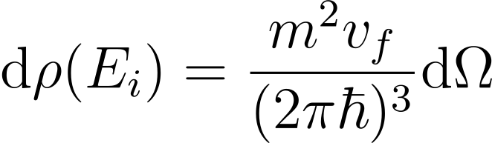
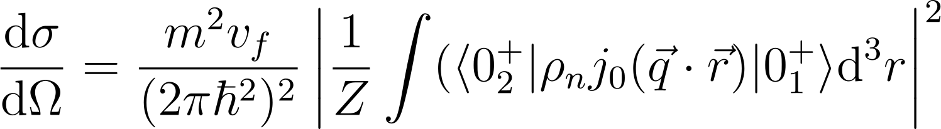
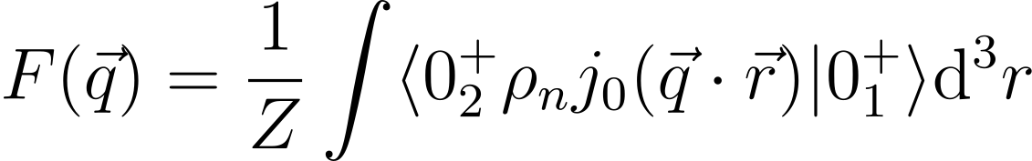
Measurements of Hoyle state
Modern measurements of Hoyle state
If we insert potenical and into we get:
And by comparing the starting example, we get form factor

Slide 10

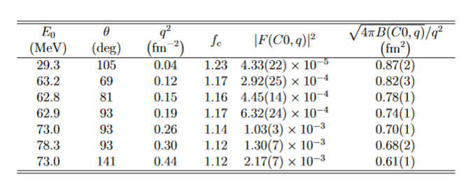
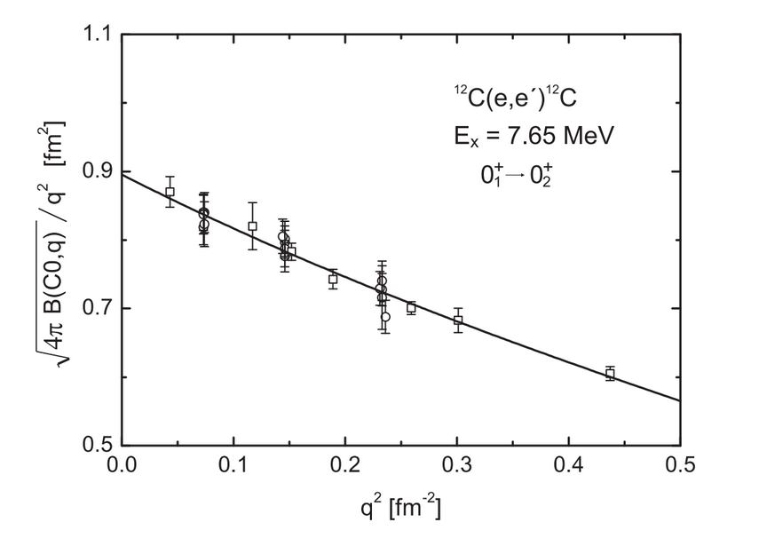
Measurements of Hoyle state
S-DALINAC experiment
Main goal: Resolve the inconsistency in
By knowing monopole matrix element, was calculated as

Slide 11
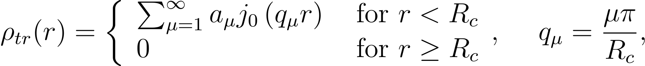
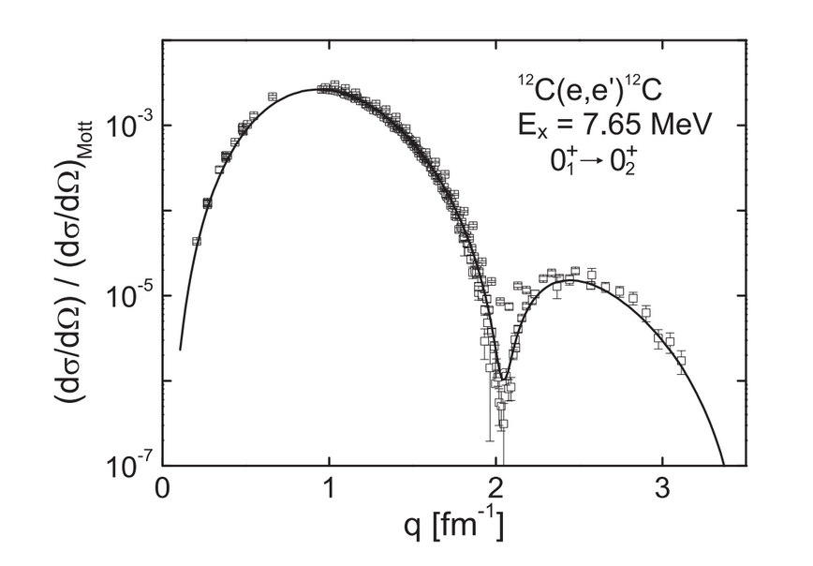

Measurements of Hoyle state
S-DALINAC experiment
But also they calculated with an alternative method; Fourier Bessel analysis
They represented density as Fourier-Bessel function
And fitted the data to calculate form factor and then corresponding monopole matrix element, which led the to

Slide 12
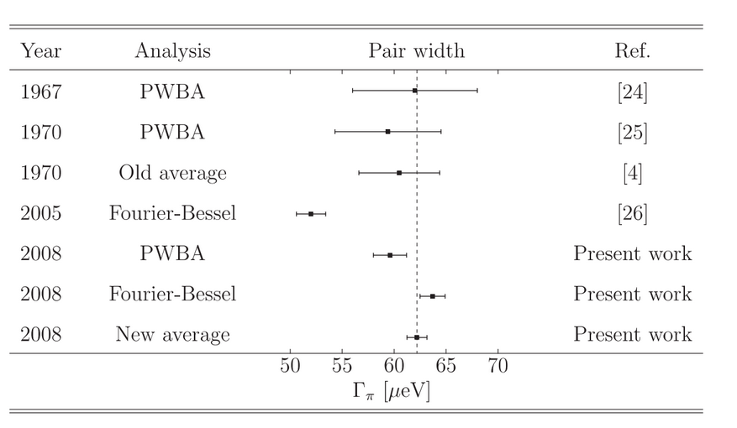
Measurements of Hoyle state
S-DALINAC experiment
To get the most precise result of partial pair width to date, they averaged results and got:

Slide 13
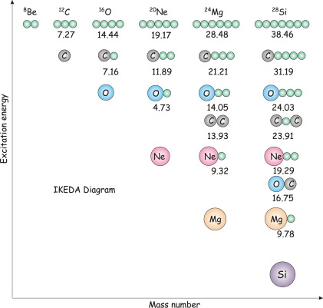
The shape and structure of the Hoyle state
The atom structure is mainly described by the Shell model: Structure where protons and neutrons are arranged in a shell with maximum number of nucleons that can occupy shells as sequemnce 2, 8, 20, 50…
Good prediction for light nuclei, fails to explain Hoyle state
Energy of Shell model and Hoyle state does not match.
The Hoyle state does not act like a group of protons and neutrons, but as a bound state of three particles

Slide 14
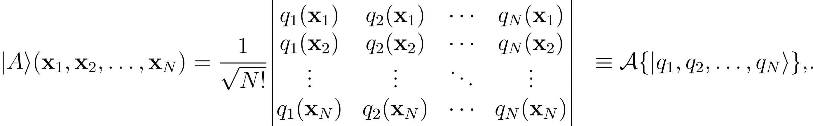
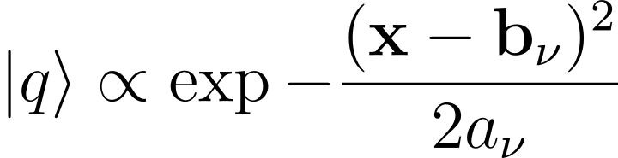
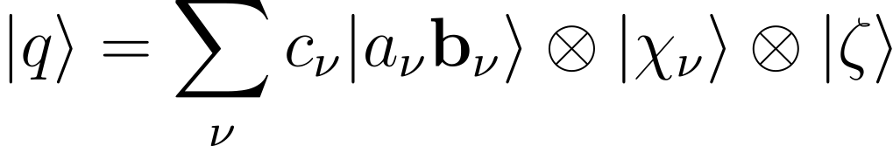
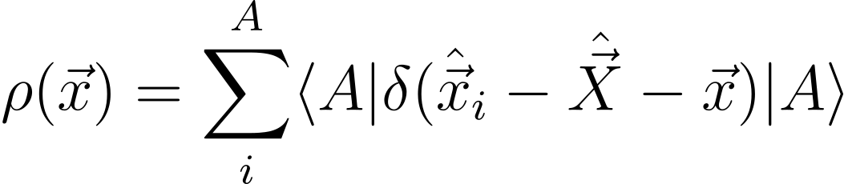
The shape and structure of the Hoyle state
Fermionic molecular dynamic model (FMD model)
Has no assumptions made about exsistance of particle clusters
Nuclear state with A nucleons is described as Slater determinant
Single particles are Gaussian wawe-packets and single nucleon state is a superposition of several such packets
Once we have full function, we can compute other physical quanitities

Slide 15
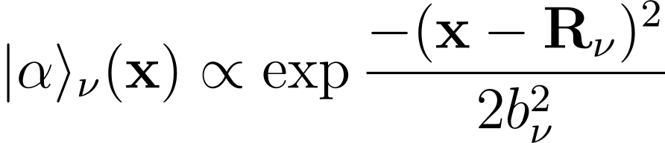
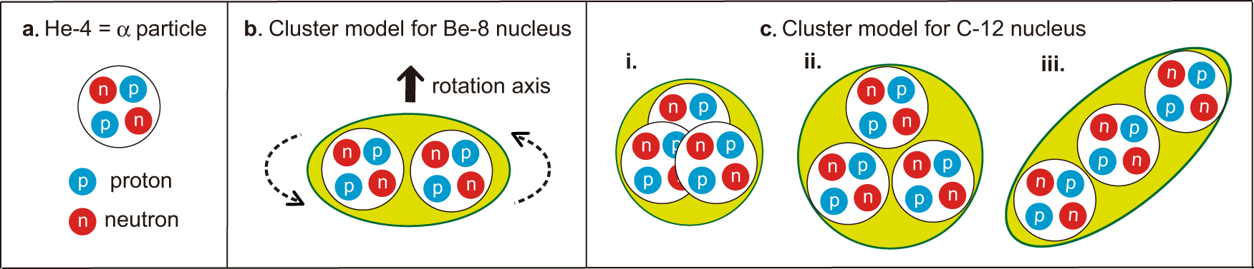
The shape and structure of the Hoyle state
Alpha Cluster Model
Single „particle“ is now a quartet of pairs of protons and neutrons.
Wawe function of one quartet is now
The wawe function of nuclei is calculated by the same principle as in FMD model (Slater determinante)

Slide 16
The shape and structure of the Hoyle state
Bose Einstein condensate model
The separation of alpha particles is so big that internal structure of particle is no longer important
System is described as 3 bosons Bose-Einstein condensate.
Wawe function of one particle is still Gaussian packet
And the state is still determinated by Slatner determinante in which we can neglect the asymmetric operator A.

Slide 17
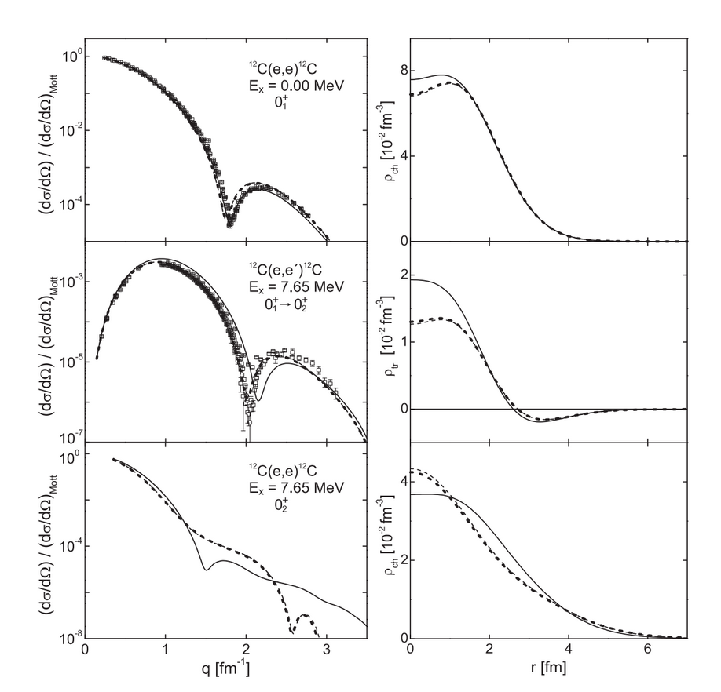
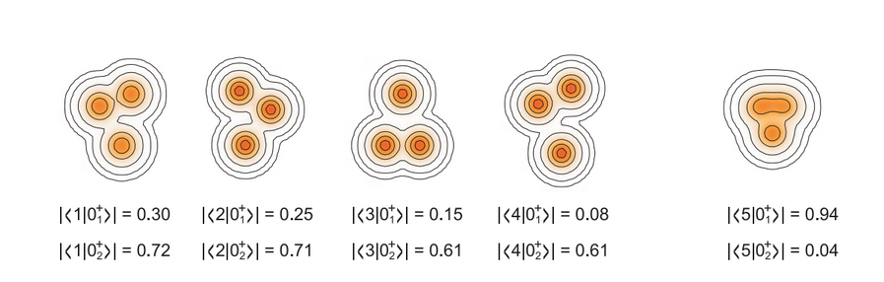
The shape and structure of the Hoyle state
Comparison of models in S-DALINAC experiment
They calculated the form factor and charge density distribution of ground and Hoyle state
FMD model gave the best interpretation of ground state, fails at Hoyle state
Hoyle state has 3 cluster structure or Be+ structure.

Slide 18
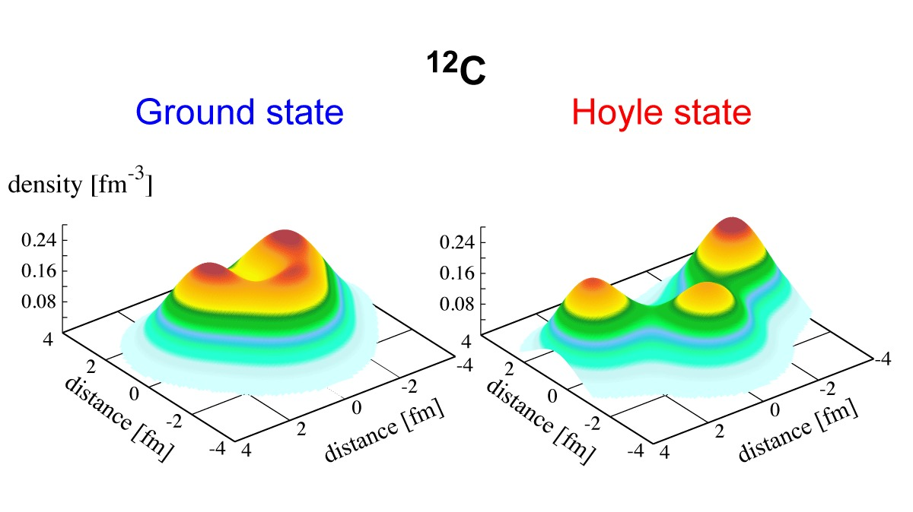
Summary
We described Hoyle state and its properties
What led to the discovery of a Hoyle state
The original experiment that confirmed Hoyle‘s state
Modern experiment which improved the measurements of radial width and form factor
Described different models which try to explain the shape of Hoyle state

